Slide 1
EMAIL APPLICATION
Team Members:
S RAMESH KRISHNAN-711222104036
P KAVIRAJ-711222104023
S DHARANISH-711222104012
M NITHISH KUMAR-711222104033

Slide 2
DESCRIPTION
Overview
Email App is a mobile application designed to streamline communication and enhance productivity. It offers an intuitive interface for managing multiple email accounts, organizing inboxes, and scheduling messages. With its modern design and efficient tools, the app provides a seamless email experience for both personal and professional use.
Material Design
Email App leverages Material Design principles to deliver a sleek, user-friendly experience. With features such as floating action buttons for composing emails, a well-structured navigation drawer, and a clean, professional color palette, the app ensures ease of use and aesthetic appeal.
Customizable Settings
Users can personalize their experience with Email App through customizable settings. Features like theme selection, notification preferences, and account-specific configurations make the app adaptable to individual needs and workflows.
Offline Mode
Email App supports offline functionality, allowing users to read, draft, and manage their emails without an internet connection. This ensures productivity even in areas with limited connectivity.
Smart Inbox
The app’s smart inbox categorizes emails into sections like Primary, Social, and Promotions, helping users focus on what’s important. Intelligent filters and search functionality make finding emails quick and hassle-free.
Scheduler and Reminders
Email App includes a scheduling feature for sending emails at specific times, making it perfect for managing workflows across different time zones. Reminder tools ensure users never miss a follow-up or important message.

Slide 3
Main Activity.java:
package com.materialstudies.owl.ui
import android.os.Bundle
import android.view.View.GONE
import android.view.View.VISIBLE
import androidx.appcompat.app.AppCompatActivity
import androidx.lifecycle.lifecycleScope
import androidx.navigation.Navigation
import androidx.navigation.ui.setupWithNavController
import com.materialstudies.owl.R
import com.materialstudies.owl.databinding.ActivityMainBinding
import com.materialstudies.owl.util.contentView
import com.materialstudies.owl.util.hide
import com.materialstudies.owl.util.show

Slide 4
package com.example.emailapplication
import android.content.Context
import androidx.room.Database
import androidx.room.Room
import androidx.room.RoomDatabase
@Database(entities = [Email::class], version = 1)
abstract class EmailDatabase : RoomDatabase() {
abstract fun emailDao(): EmailDao
companion object {
@Volatile
private var instance: EmailDatabase? = null
fun getDatabase(context: Context): EmailDatabase {
return instance ?: synchronized(this) {
val newInstance = Room.databaseBuilder(
context.applicationContext,
EmailDatabase::class.java,
"email_database"
).build()
instance = newInstance
newInstance
}
}
}
}

Slide 5
AndroidManifest.xml
<?xml version="1.0" encoding="utf-8"?>
<manifest xmlns:android="http://schemas.android.com/apk/res/android"
xmlns:tools="http://schemas.android.com/tools" >
<application
android:allowBackup="true"
android:dataExtractionRules="@xml/data_extraction_rules"
android:fullBackupContent="@xml/backup_rules"
android:icon="@mipmap/ic_launcher"
android:label="@string/app_name"
android:supportsRtl="true"
android:theme="@style/Theme.EmailApplication"
tools:targetApi="31" >
<activity
android:name=".RegisterActivity"
android:exported="false"
android:label="@string/title_activity_register"
android:theme="@style/Theme.EmailApplication" />
<activity
android:name=".MainActivity"
android:exported="false"

Slide 6
android:label="MainActivity"
android:theme="@style/Theme.EmailApplication" />
<activity
android:name=".ViewMailActivity"
android:exported="false"
android:label="@string/title_activity_view_mail"
android:theme="@style/Theme.EmailApplication" />
<activity
android:name=".SendMailActivity"
android:exported="false"
android:label="@string/title_activity_send_mail"
android:theme="@style/Theme.EmailApplication" />
<activity
android:name=".LoginActivity"
android:exported="true"
android:label="@string/app_name"
android:theme="@style/Theme.EmailApplication" >
<intent-filter>
<action android:name="android.intent.action.MAIN" />
<category android:name="android.intent.category.LAUNCHER" />
</intent-filter>
</activity>
</application>
</manifest>

Slide 7
FONT
rubik.xml
<?xml version="1.0" encoding="utf-8"?>
<font-family
xmlns:app="http://schemas.android.com/apk/res-auto"
app:fontProviderAuthority="com.google.android.gms.fonts"
app:fontProviderPackage="com.google.android.gms"
app:fontProviderQuery="Rubik"
app:fontProviderCerts="@array/com_google_android_gms_fonts_certs">
</font-family>
rubik_bold.xml
<?xml version="1.0" encoding="utf-8"?>
<font-family
xmlns:app="http://schemas.android.com/apk/res-auto"
app:fontProviderAuthority="com.google.android.gms.fonts"

Slide 8
app:fontProviderPackage="com.google.android.gms"
app:fontProviderQuery="name=Rubik&amp;weight=700"
app:fontProviderCerts="@array/com_google_android_gms_fonts_certs">
</font-family>
rubik_medium.xml
<?xml version="1.0" encoding="utf-8"?>
<font-family
xmlns:app="http://schemas.android.com/apk/res-auto"
app:fontProviderAuthority="com.google.android.gms.fonts"
app:fontProviderPackage="com.google.android.gms"
app:fontProviderQuery="name=Rubik&amp;weight=500"
app:fontProviderCerts="@array/com_google_android_gms_fonts_certs">
</font-family>

Slide 9
LAYOUT
activity_main.xml
<?xml version="1.0" encoding="utf-8"?>
<layout
xmlns:android="http://schemas.android.com/apk/res/android"
xmlns:app="http://schemas.android.com/apk/res-auto"
xmlns:tools="http://schemas.android.com/tools">
<LinearLayout
android:id="@+id/root"
android:layout_width="match_parent"
android:layout_height="match_parent"
android:orientation="vertical"
app:layoutFullscreen="@{true}"
tools:context=".ui.MainActivity">
<fragment
android:id="@+id/nav_host"
android:name="androidx.navigation.fragment.NavHostFragment"
android:layout_width="match_parent"
android:layout_height="0dp"

Slide 10
android:layout_weight="1"
app:defaultNavHost="true"
app:navGraph="@navigation/navigation"/>
<com.google.android.material.bottomnavigation.BottomNavigationView
android:id="@+id/bottom_nav"
android:layout_width="match_parent"
android:layout_height="wrap_content"
android:visibility="gone"
app:menu="@menu/main"/>
</LinearLayout>
</layout>
Course_item.xml
<?xml version="1.0" encoding="utf-8"?>
<layout
xmlns:android="http://schemas.android.com/apk/res/android"
xmlns:app="http://schemas.android.com/apk/res-auto"
xmlns:tools="http://schemas.android.com/tools"
tools:targetApi="o"
tools:ignore="RtlSymmetry">

Slide 11
<data>
<variable
name="course"
type="com.materialstudies.owl.model.Course"/>
<variable
name="clickHandler"
type="com.materialstudies.owl.ui.mycourses.CourseViewClick"/>
</data>
<androidx.constraintlayout.widget.ConstraintLayout
android:id="@+id/course_item"
android:layout_width="match_parent"
android:layout_height="wrap_content"
android:layout_marginStart="32dp"
android:onClick="@{(v) -> clickHandler.onClick(v, course.id)}"
android:transitionName="@{course.name}"
android:theme="@style/ThemeOverlay.Owl.TransitionShapeAppearance.Small">
<View
android:id="@+id/background"
android:layout_width="0dp"
android:layout_height="0dp"
app:layout_constraintEnd_toEndOf="parent"

Slide 12
app:layout_constraintTop_toTopOf="@id/course_name"
app:layout_constraintBottom_toBottomOf="@id/course_steps"
app:layout_constraintStart_toStartOf="@id/course_name"
app:elevationOverlay="@{@dimen/card_elevation}"/>
<Space
android:id="@+id/space"
android:layout_width="0dp"
android:layout_height="0dp"
app:layout_constraintStart_toStartOf="parent"
app:layout_constraintTop_toTopOf="parent"
app:layout_constraintEnd_toStartOf="@id/course_image"/>
<ImageView
android:id="@+id/course_image"
android:layout_width="0dp"
android:layout_height="0dp"
app:layout_constraintStart_toEndOf="@id/space"
app:layout_constraintEnd_toStartOf="@id/course_name"
app:layout_constraintTop_toTopOf="@id/course_name"
app:layout_constraintBottom_toBottomOf="@id/course_steps"
app:layout_constraintDimensionRatio="1:1"
app:srcCompat="@drawable/stroked_course_image_placeholder"

Slide 13
android:scaleType="centerCrop"
android:contentDescription="@{course.thumbContentDesc}"/>
<TextView
android:id="@+id/course_name"
android:layout_width="0dp"
android:layout_height="wrap_content"
app:layout_constraintStart_toEndOf="@id/course_image"
app:layout_constraintTop_toTopOf="parent"
app:layout_constraintEnd_toEndOf="parent"
app:layout_constraintHorizontal_weight="1"
android:paddingHorizontal="@dimen/grid_2"
android:paddingTop="@dimen/grid_2"
android:lines="2"
android:ellipsize="end"
android:text="@{course.name}"
android:textAppearance="?attr/textAppearanceSubtitle1"
tools:text="@sample/courses.json/data/name"/>
<ImageView
android:id="@+id/course_icon"
android:layout_width="wrap_content"
android:layout_height="wrap_content"

Slide 14
app:layout_constraintStart_toStartOf="@id/course_name"
app:layout_constraintTop_toTopOf="@id/course_steps"
app:layout_constraintBottom_toBottomOf="@id/course_steps"
android:paddingStart="@dimen/grid_2"
app:srcCompat="@drawable/ic_course"
app:tint="?attr/colorPrimary"
android:importantForAccessibility="no"/>
<TextView
android:id="@+id/course_steps"
android:layout_width="0dp"
android:layout_height="wrap_content"
app:layout_constraintStart_toEndOf="@id/course_icon"
app:layout_constraintEnd_toStartOf="@id/course_instructor"
app:layout_constraintTop_toBottomOf="@id/course_name"
app:layout_constraintBottom_toBottomOf="parent"
android:paddingStart="@dimen/grid_1"
android:paddingVertical="@dimen/grid_2"
android:textColor="?attr/colorPrimary"
android:textAppearance="?attr/textAppearanceCaption"
android:text="@{@string/course_steps(course.step, course.steps)}"
tools:text="@sample/courses.json/data/step"/>

Slide 15
<ImageView
android:id="@+id/course_instructor"
android:layout_width="28dp"
android:layout_height="28dp"
app:layout_constraintEnd_toEndOf="parent"
app:layout_constraintStart_toEndOf="@id/course_steps"
app:layout_constraintTop_toTopOf="@id/course_steps"
app:layout_constraintBottom_toBottomOf="@id/course_steps"
android:layout_marginEnd="@dimen/grid_2"
app:srcUrl="@{course.instructor}"
app:placeholder="@{@drawable/ic_avatar_placeholder}"
app:circleCrop="@{true}"
android:importantForAccessibility="no"/>
<View
android:id="@+id/highlight"
android:layout_width="0dp"
android:layout_height="0dp"
app:layout_constraintStart_toStartOf="@id/course_image"
app:layout_constraintTop_toTopOf="parent"
"

Slide 16
app:layout_constraintEnd_toEndOf="parent"
app:layout_constraintBottom_toBottomOf="parent"
android:foreground="@drawable/small_component_foreground"/>
</androidx.constraintlayout.widget.ConstraintLayout>
</layout>
<?xml version="1.0" encoding="utf-8"?>
<layout
xmlns:android="http://schemas.android.com/apk/res/android"
xmlns:app="http://schemas.android.com/apk/res-auto"
xmlns:tools="http://schemas.android.com/tools">
<androidx.coordinatorlayout.widget.CoordinatorLayout
android:layout_width="match_parent"
android:layout_height="match_parent"
android:background="?attr/colorPrimarySurface"

Slide 17
android:theme="@style/Owl.Blue"
app:paddingTopSystemWindowInsets="@{true}"
app:paddingLeftSystemWindowInsets="@{true}"
app:paddingRightSystemWindowInsets="@{true}"
tools:context=".ui.search.SearchFragment">
<com.google.android.material.appbar.AppBarLayout
android:layout_width="match_parent"
android:layout_height="wrap_content"
app:liftOnScroll="true"
app:liftOnScrollTargetViewId="@id/search_results"
android:theme="@style/ThemeOverlay.Owl.Blue.Dark">
<androidx.appcompat.widget.Toolbar
android:layout_width="match_parent"
android:layout_height="wrap_content"
app:layout_scrollFlags="scroll|enterAlways|snap"
android:minHeight="?attr/actionBarSize"
app:navigationIcon="@drawable/ic_search"
app:contentInsetStartWithNavigation="0dp"
app:menu="@menu/account">

Slide 18
<EditText
android:layout_width="match_parent"
android:layout_height="wrap_content"
android:background="@null"
android:lines="1"
android:selectAllOnFocus="true"
android:inputType="textCapWords"
android:imeOptions="actionSearch"
android:hint="@string/search_owl"
android:textAppearance="?attr/textAppearanceSubtitle1"/>
</androidx.appcompat.widget.Toolbar>
</com.google.android.material.appbar.AppBarLayout>
<androidx.recyclerview.widget.RecyclerView
android:id="@+id/search_results"
android:layout_width="match_parent"
android:layout_height="match_parent"

Slide 19
app:layout_behavior="com.google.android.material.appbar.AppBarLayout$ScrollingViewBehavior"
app:layoutManager="androidx.recyclerview.widget.LinearLayoutManager"
app:hasFixedSize="@{true}"
android:scrollbars="vertical"
tools:listitem="@layout/search_item"/>
</androidx.coordinatorlayout.widget.CoordinatorLayout>
</layout>

Slide 20
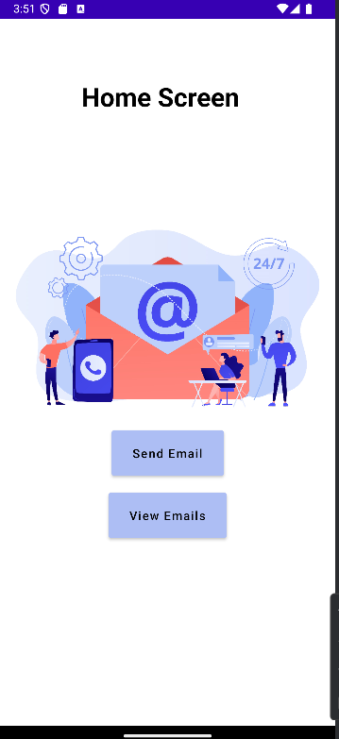
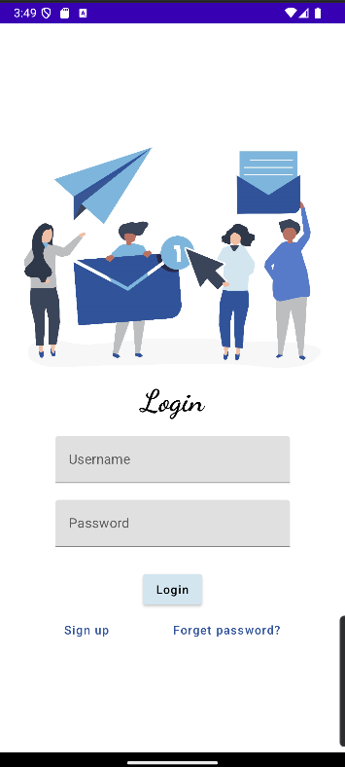
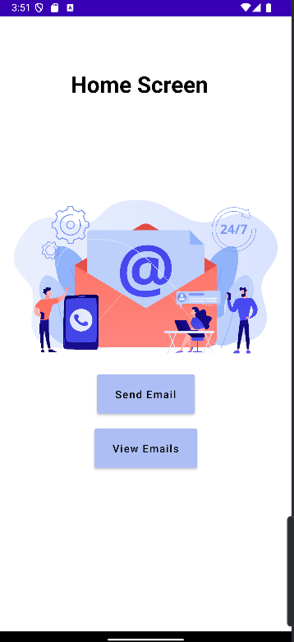
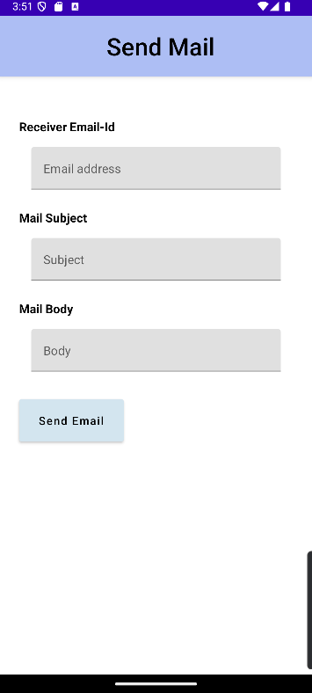
OUTPUT:

Slide 21
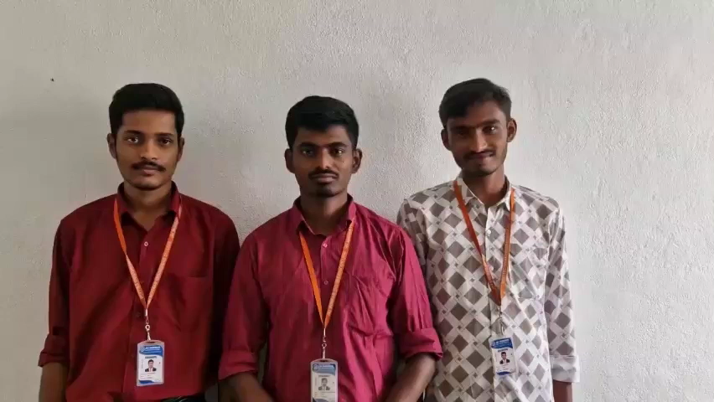
Demo video:

